Slide 1
Shell Bootcamp 2024 3 Reflections for Week #1
Dharya Pratap Singh
Date : 30-Aug-2024

Slide 2

About Me
If you can imagine it, you can achieve it.

Slide 3

My learnings from this week!

Slide 4

Learning 1 | My takeaways
I learnt the importance of communication and teamwork using various activities.
The key takeaways for me was that your line of communication should be open to everyone, and you should be a good team member for the project to succeed.
I can see this implemented as an important part of energy sector because it will be very important to communicate and work together for everyone involved in the organization to find cleaner sources of energy to reach the goal of zero net emissions.

Slide 5
Learning 2 | My takeaways
I learnt about the importance of stakeholder management using various activities.
The key takeaway for me was that it is very important to understand the expectations of the stakeholders from the project and to keep them regularly engaged
I can see this implemented as an important part of energy sector because it will be very important to communicate with all the stakeholders transparently and clearly to make sure everyone is on the same page of reducing carbon emissions while ensuring profitability.
[Add a graphic that provides evidence of what you did to overcome this challenge]

Slide 6
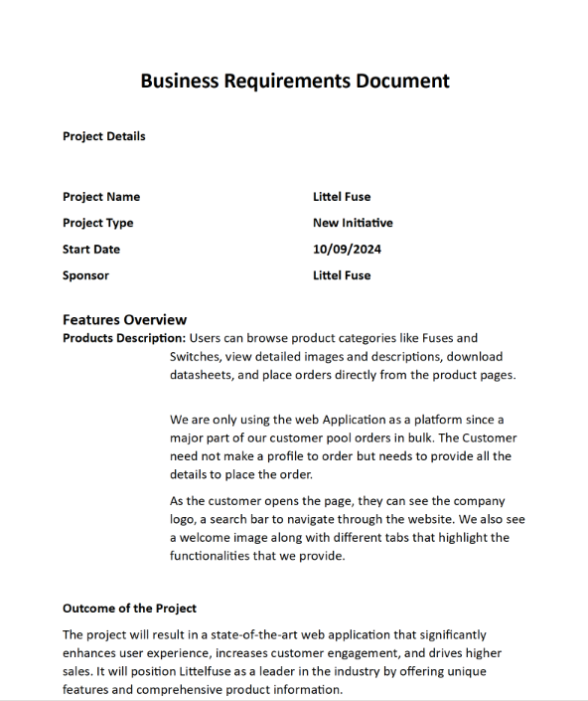
Learning 3 | My takeaways
I learnt about Business Requirement Document (BRD) and Software Requirement Specification (SRS) Document
The key takeaway for me was that it’s very important to know about different stages of software development cycle and to document every stage of the development.
I can see this implemented by the in-house software development teams of the energy sector organizations that will help track each stage of development in detail.

Slide 7

Relevance of learnings for my organization

Slide 8
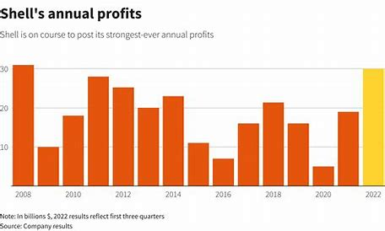
Learning 1 | Relevance for Shell
I feel Shell implements this learning in a very effective manner. The Shell as an organization is very open, and everyone can communicate with every other person which makes it a suitable ground for innovation and progress for the organization
I feel Shell benefits from this learning by attracting and retaining top talents from various domains by providing them a ground to learn, grow and collaborate with others. As a result of which Shell is one of the leaders of its industries, both in advancement of technology and profit.

Slide 9
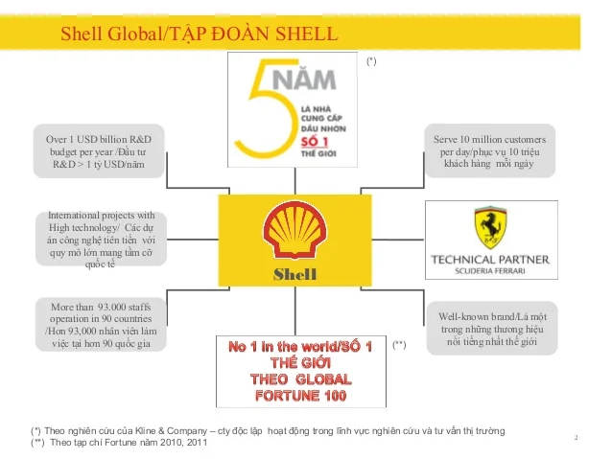
Learning 2 | Relevance for Shell
I feel Shell implements this learning very effective. The Shell as an organization is very transparent with all its stakeholders and make sure all their expectations are being met.
I feel Shell benefits from this learning by keeping all their stakeholders satisfied and by gaining more support from their stakeholders which allows them to grow and keep advancing in their field as an industry leader.

Slide 10
Learning 3 | Relevance for Shell
I feel Shell implements this learning very effectively. The Shell IT business operations teams are very proficient in their job and performs an excellent task of keeping every stage of the development well documented.
I feel Shell benefits from this learning by having detailed knowledge of every stage of the development which allows them to know exactly how much time a project is going to take, which also helps them in planning for the future projects accordingly.
[Add a graphic that provides view of how Shell implements this learning]

Slide 11

Challenges in implementing learning

Slide 12
Challenge faced while implementing Learning 1
The biggest challenge I faced in implementing the learning 1 was coming out of comfort zone. The activities involved for this learning demanded me to come out of comfort zone and to collaborate with other team members and to present our project.
I plan to overcome this challenge by being more involved in group related activities and by giving more presentations.
[Add a graphic that provides evidence of what you did to overcome this challenge]

Slide 13
Challenge faced while implementing Learning 2
The biggest challenge I faced in implementing the learning 2 was taking all the stakeholders expectations into considerations and making sure all their expectations are met simultaneously.
I plan to overcome this challenge by being more understanding of the expectations of the stakeholders and by engaging with them more frequently.
[Add a graphic that provides evidence of what you did to overcome this challenge]

Slide 14
Challenge faced while implementing Learning 3
The biggest challenge I faced in implementing the learning 3 was understanding the business significance of the project. Its easy to understand the technical requirements of an application but it requires additional skills to understand the business significance of the application.
I plan to overcome this challenge by studying real life business significance of existing applications and by improving my managerial side skills.
[Add a graphic that provides evidence of what you did to overcome this challenge]

Slide 15

Action Plan

Slide 16
My Action Plan for this Week
Actions
Timeline
Status
My action plan for this week is to learn the industry relevant applications of every topic that is taught to us and to go and revise these topics at home everyday
The planned timeline to implement the actions in one week
I have successfully learnt the industry relevant applications of the topics that were taught this week

Slide 17

Learning is also Fun!

Slide 18
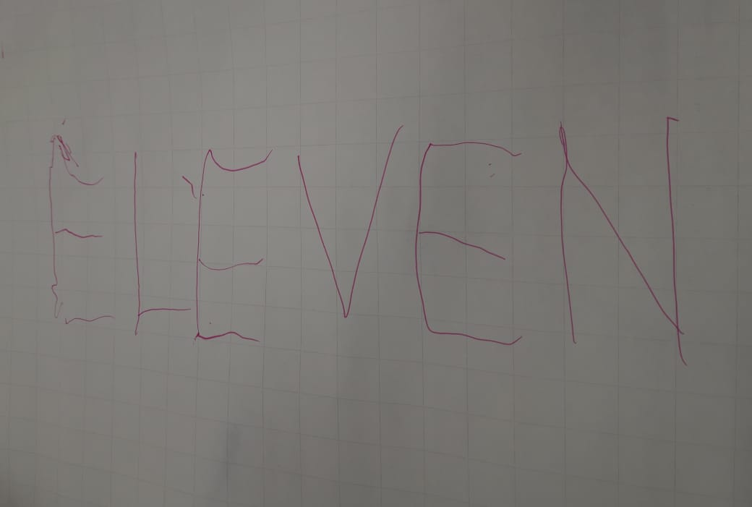
Learning is also Fun!
One of the group activity that was given to us was to write a six or more letters word. The catch was that we need to do this in a group of four where every person will hold the threads that will be attached to the pen. Then all of the four team members need to write the chosen word by coordinating together and the word that we chose was ‘Eleven’
The funny incident which had an element of learning from this week’s topic was this word writing activity only. In this the funny thing was as we started writing the word, the letters were not understandable but as the activity progressed, we were able to improve our performance by improving team coordination.

Slide 19

Summary
The overall week was very informative and interactive. In the first half of the week we learned about the importance of behavioral skills and communication. We also performed various activities that was very fun and collaborative. In the second half of the week we learned about the various stages of the software development cycle. We also learned about different types of software development models and then we studied Agile methodology in detail.
The upcoming week will be very important from the technical side. In the upcoming week we will be learning about the fundamentals and industry relevant information about the DBMS, DevOps and Testing.
The topics of this upcoming week will be in continuation of the technical learning that we did during the second half of this week. Thus, the upcoming week learning will be a smooth transition from the current week learning.

Slide 20
Thank You

Slide 21
Shell Bootcamp 2024 3 Reflections for Week #2
Dharya Pratap Singh
Date : 06-Sep-2024

Slide 22
About Me
If you can imagine it, you can achieve it.

Slide 23
My learnings from this week!

Slide 24
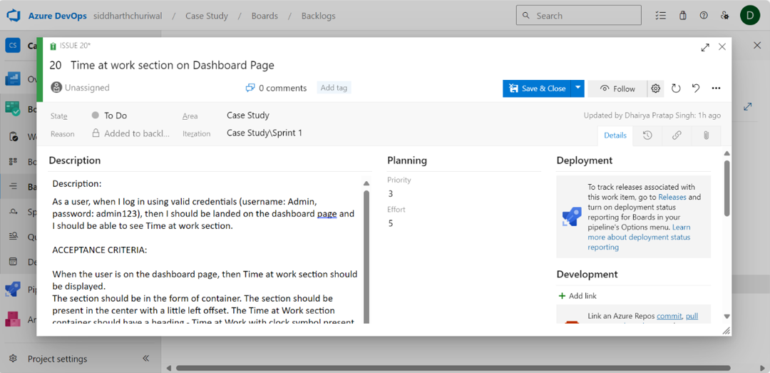
Learning 1 | My takeaways
I learnt how to make EPICS from SRS and then how to make user stories from EPICS
The key takeaways for me was that user stories should be very specific because both developers and testers will be using user stories to develop and test the functionality; and we also we need to make sure a user story can be implemented within a sprint
I can see this implemented by the in-house development teams of energy sector organization for the development processes

Slide 25
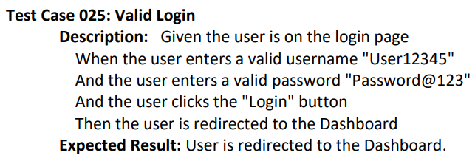
Learning 2 | My takeaways
I learnt how to make test cases in Gherkin language from user stories
The key takeaway for me was that functional testing is done by executing the test cases made from the user stories. We don’t test any functionality which is not mentioned in the test case
I can see this implemented by the in-house development teams of energy sector organization for the testing processes

Slide 26
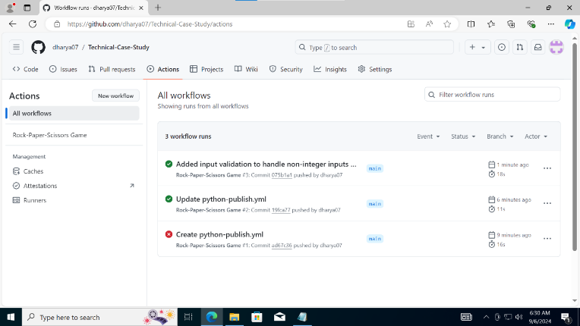
Learning 3 | My takeaways
I learned how to make Azure virtual machine and how to build CI/CD pipeline using Github Actions to automate the workflow and streamline the process of integration and deployment
The key takeaway was that its very important to use virtual machine to maintain privacy of the project and automate the workflow by building CI/CD pipeline when a large team of developers are working on a large and complex project. This helps us in saving a lot of time and effort in integrating and deploying code.
I can see this implemented by the in-house development teams of energy sector organization for automating the integration and deployment and thus saving their lot of time and effort.

Slide 27
Relevance of learnings for my organization

Slide 28
Learning 1 | Relevance for Shell
I feel Shell implements this learning in a very effective manner. The Shell has a very good IT operations team which follows the latest development in technology to work on its internal projects that include making user stories to develop its project functionalities.
I feel Shell benefits from this learning by attracting and retaining top talents from various domains by providing them a ground to learn, grow and collaborate with others. As a result of which Shell is one of the leaders of its industries, both in technology and profitability.
[Add a graphic that provides view of how Shell implements this learning]

Slide 29
Learning 2 | Relevance for Shell
I feel Shell implements this learning very effectively. The IT operations team of Shell make sure to find defects by executing all the test cases. Thus, making sure their software's are up to the standards.
I feel Shell benefits from this learning by developing great IT technologies which allows them to grow and keep advancing in their field as an industry leader.
[Add a graphic that provides view of how Shell implements this learning]

Slide 30
Learning 3 | Relevance for Shell
I feel Shell implements this learning very effectively. The Shell IT business operations teams are very proficient in their job and performs an excellent task of automating the workflow and of building CI/CD pipeline.
I feel Shell benefits from this learning by automating the integration and development process. Thus, saving a lot of time, effort, money and resources of the organization. As a result, they can focus on other higher priority tasks.
[Add a graphic that provides view of how Shell implements this learning]

Slide 31
Challenges in implementing learning

Slide 32
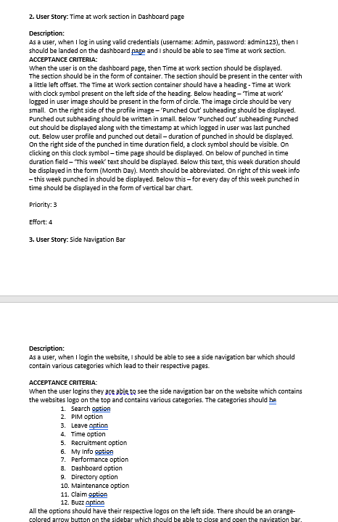
Challenge faced while implementing Learning 1
The challenge I faced in implementing the learning 1 was understanding what comprises a user story
I plan to overcome this challenge by practicing developing more user stories and by studying user story used in real development project.

Slide 33
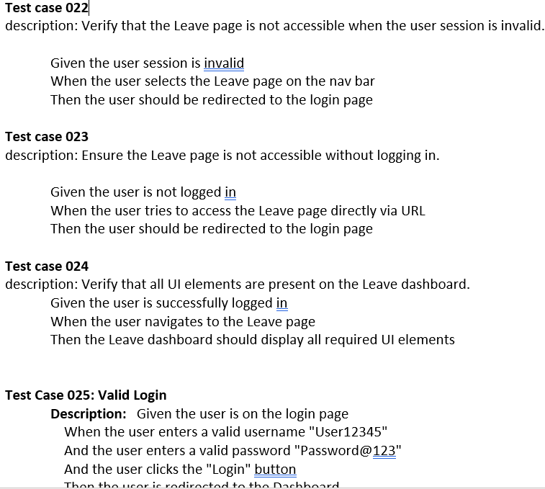
Challenge faced while implementing Learning 2
The biggest challenge I faced in implementing the learning 2 was understanding what all needs to be present in a test case. I face this problem a number of times.
I plan to overcome this challenge by practicing developing more test cases and by analyzing test cases used in real development project.

Slide 34

Challenge faced while implementing Learning 3
The biggest challenge I faced was configuring virtual machine. The other challenge I faced was understanding all the steps involved in building CI/CD pipeline. Configuring the yml file was also challenging.
I plan to overcome this challenge by practicing developing more virtual machine and by building CI/CD pipelines for different projects

Slide 35
Action Plan

Slide 36
My Action Plan for this Week
Actions
Timeline
Status
My action plan for this week is to revise all the topics we studied. This includes creating user stories, test cases, virtual machine and building CI/CD pipeline
The planned timeline to implement the actions in one week

Slide 37
Learning is also Fun!

Slide 38
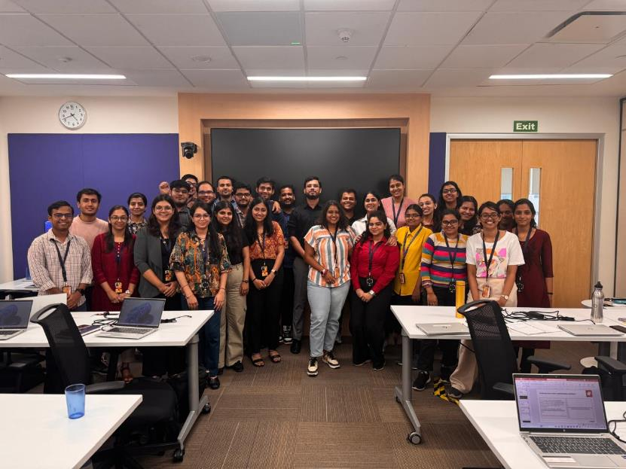
Learning is also Fun!
The overall session was jam packed with learning which was very useful and relevant for our industry. The learning was mixed with funny anecdotes which made the learning fun. The learning was not boring at all.
We had multiple funny incidents which had an element of learning from this week’s topic. One of the incident was when a student made a silly mistake during an activity which made that topic rememberable.

Slide 39
Summary
The overall week was full of technical sessions. We performed various activities that helped us in understanding the concepts in depth. We learned about different types of software development life cycle models, software testing life cycle. We also learnt how to create Azure virtual machine, how to build CI/CD pipeline using Github Actions. We also learnt about DBMS, Postgresql, and Cloud.
The upcoming week will be very important from the technical side of the view. In the upcoming week we will be learning about .Net, c#, Application security and experience design. And on the last of the week, we will be building an app.
The topics of this upcoming week will be in continuation of the technical learning that we did during the second half of this week. Thus, the upcoming week learning will be a smooth transition from the current week learning.

Slide 40
Thank You

